Slide 1

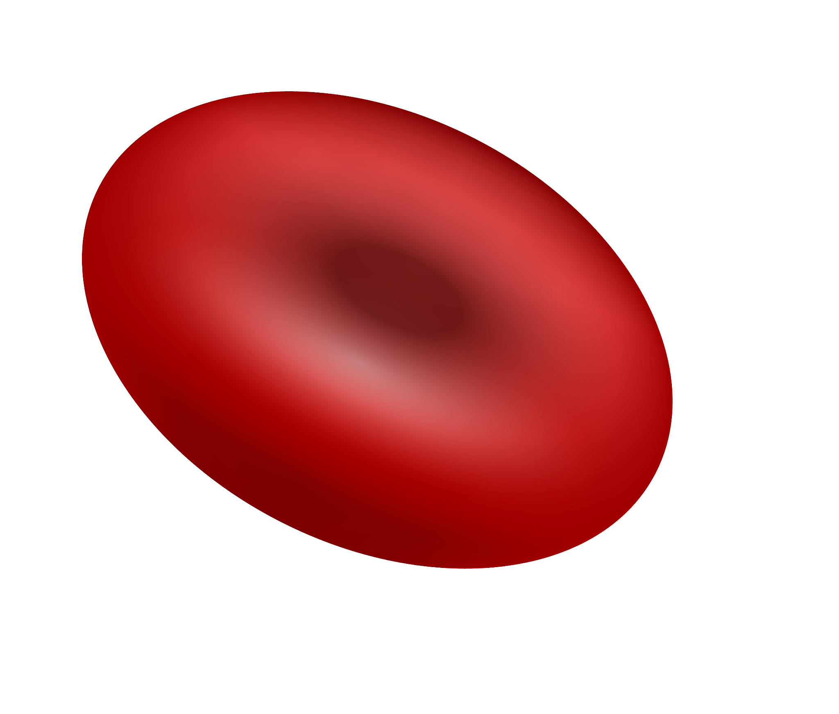
Determination of Methemoglobin in Blood Hemiglobincyanide Method
Tim Peko

Slide 2
Table of contents
01
02
03
04
05
06
Hemoglobin Structure
Methemoglobin
Hemiglobincyanide Method
Reflotron Method
Results
Conclusion

Slide 3
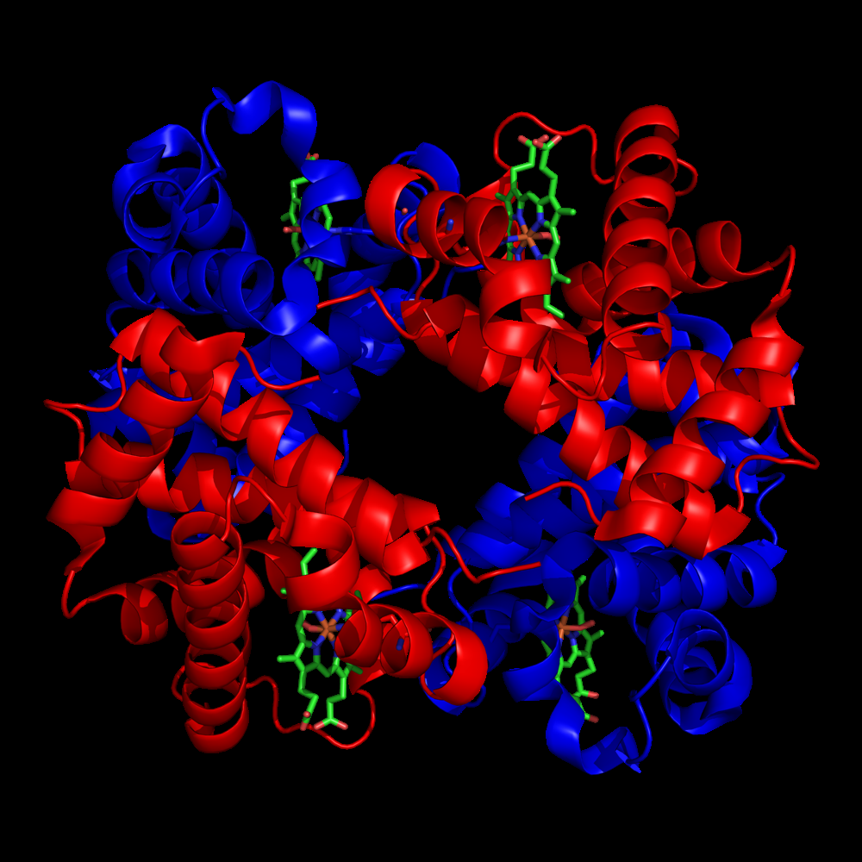
Hemoglobin molecule
Hemoglobin (Hb) is an iron-containing protein in red blood cells that transports oxygen from the lungs to tissues:
2 α-, 2 β- globin chains
one O₂ molecule per chain
one heme group per chain
ferrous iron (Fe²⁺) per heme
ferric iron (Fe³⁺) does not work
Notes:
Hb = O₂ carrier, 4 subunits: 2α (red), 2β (blue)
Each subunit: heme (green) + Fe²⁺ → binds O₂
Fe³⁺ = MetHb → no O₂ binding
Speaker Notes:
Hb = tetramer, heme groups
Fe²⁺ binds O₂ → reversible transport
Fe³⁺ = oxidized, no O₂ binding → MetHb
Red color from heme/Fe
Key: oxidation state of Fe controls function
Hemoglobin (Hb): oxygen carrier in red blood cells
4 subunits: 2α, 2β; each with heme + iron (Fe²⁺)
O₂ binds to Fe²⁺; Fe³⁺ = methemoglobin (non-functional)
Speaker Notes Keywords:
Hb structure
Fe²⁺ binds O₂
Fe³⁺ = MetHb
O₂ transport
Tetramer

Slide 4
Methemoglobin
MetHb
Formation
iron is oxidized to Fe³⁺ instead of Fe²⁺ = ferrihemoglobin
brownish in color and cannot reversibly bind oxygen
Hb oxidizes over time, small MetHb amounts in humans
enzymes reduce Fe³⁺ back to Fe²⁺
high MetHb ➡️ cyanosis, oxygen deprivation symptoms
Notes:
MetHb = Fe³⁺ Hb, brown, inactive
Normal level ≤1%, reduced by enzymes
Causes: drugs (nitrites), chemicals
Symptoms: cyanosis, hypoxia
Speaker Notes:
MetHb = ferric Hb → can’t carry O₂
Enzymes keep MetHb low
Excess MetHb → methemoglobinemia
Induced by oxidants (benzocaine, nitrates)
Chocolate-brown blood, O₂ delivery impaired
MetHb = Fe³⁺ form; cannot carry O₂
Normally ≤1% MetHb; reduced by enzymes
High MetHb → cyanosis, hypoxia
Causes: drugs (e.g. nitrites), chemicals
Speaker Notes Keywords:
MetHb = Fe³⁺
No O₂ binding
Enzyme reduction
Methemoglobinemia
Oxidizing agents

Slide 5
Hemiglobincyanide Method
Components
Drabkin’s reagent | potassium ferricyanide KHC(III) and potassium cyanide KCN
Dilution | blood sample in Drabkin’s solution diluted 1:250
Chemical reaction | hemoglobin and derivatives form cyanmethemoglobin
Wavelength measuring | absorption measurement at 546nm
Beer-Lambert | convert absorption value to Hb concentration
General
1
cyanmethemoglobin or hemiglobincyanide (HiCN) method
2
reference method recommended internationally for hemoglobin measurement
Goal
hemoglobin in sample ➡️ single stable form cyanmethemoglobin
photometric quantification
Notes:
Converts all Hb → stable HiCN for measurement
Uses Drabkin’s reagent (K₃Fe(CN)₆ + KCN)
Ferricyanide oxidizes Hb → MetHb
Cyanide binds → forms HiCN
Measure absorbance @ 546 nm
Speaker Notes:
Goal: 1 stable Hb form → HiCN
Ferricyanide: oxidizes Fe²⁺ → Fe³⁺
Cyanide: binds Fe³⁺ → HiCN complex
Stable, colored, absorbs at 540–546 nm
Measures total Hb (except sulfHb)
Standard lab method (WHO reference)
Converts all Hb → cyanmethemoglobin (HiCN)
Uses Drabkin’s reagent (K₃Fe(CN)₆ + KCN)
Oxidation: Fe²⁺ → Fe³⁺ → binds CN⁻ → HiCN
Absorbance at 540–546 nm ∝ [Hb]
Speaker Notes Keywords:
Drabkin’s reagent
Fe²⁺ → Fe³⁺
CN⁻ binds → HiCN
Photometric detection
546 nm absorbance

Slide 6
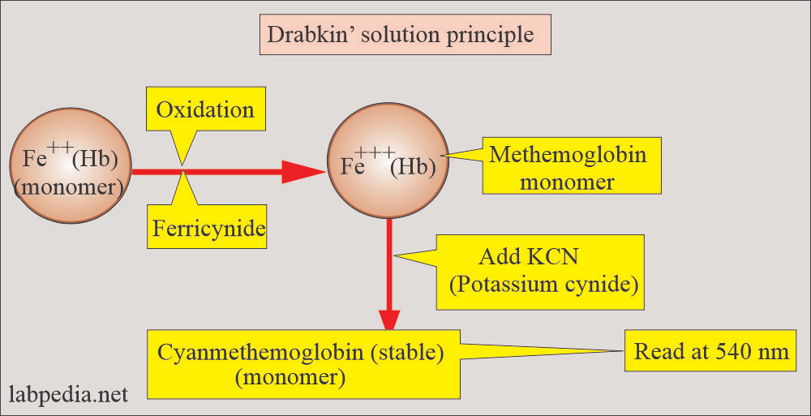
Reaction pathway diagram
Start
Oxidization
Stabilization
Hb (Fe²⁺) + ferricyanide ➡️ MetHb (Fe³⁺)
MetHb + CN⁻ ➡️ HiCN (Cyanmethemoglobin)
End
Notes:
Visualize 2-step reaction
Step 1: oxidation → MetHb
Step 2: CN⁻ binds → HiCN
Ferricyanide: redox agent
Cyanide: complexing agent
HiCN = stable endpoint → absorbance read
Step 1: Hb (Fe²⁺) + ferricyanide → MetHb (Fe³⁺)
Step 2: MetHb + CN⁻ → HiCN
Speaker Notes Keywords:
Step 1: oxidation
Step 2: cyanide binding
Reaction path
Visual chemistry
Stable HiCN

Slide 7
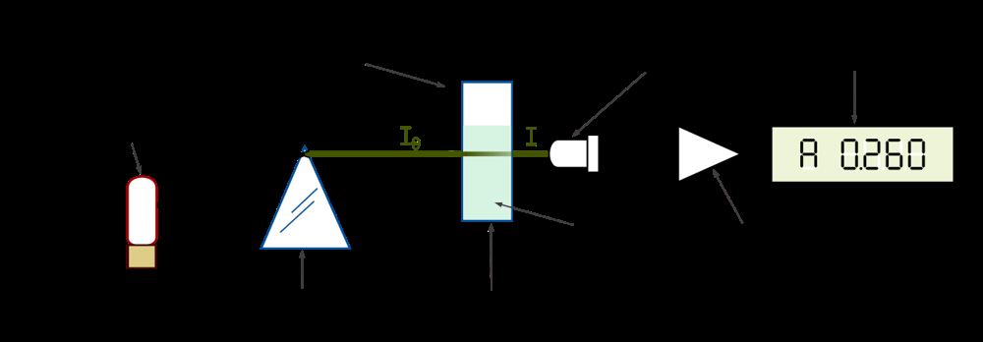
Photometric measurement
Age
Genetics
Waiting time
Many diseases occur more frequently in certain age brackets
Some diseases have a hereditary component and can be passed down through families
sample reaction time: 3-5 minutes
HiCN contained in solution
Setup
Measurement
Safety
λ = 546nm ≈ 540nm peak
zero using a blank cuvette containing only Drabkin’s solution
absorbance proportianal to the Hb concentration
Beer-Lambert equation E₅₄₆ to Hb concentration
Drabkin’s reagent contains cyanide
handle with care, prevent excessive breathing in
Notes:
20 µL blood + 5 mL Drabkin’s → mix
Wait ≥5 min in dark
Blank = reagent only
Measure sample @ 546 nm
Optional: standard
Speaker Notes:
Mix → lyse RBCs, convert Hb → HiCN
5 min incubation → full reaction
Blank = zero reference
Spectrophotometer reads E₅₄₆
Compare sample vs standard (if used)
Follow biosafety: gloves, no food, disinfect

Slide 8
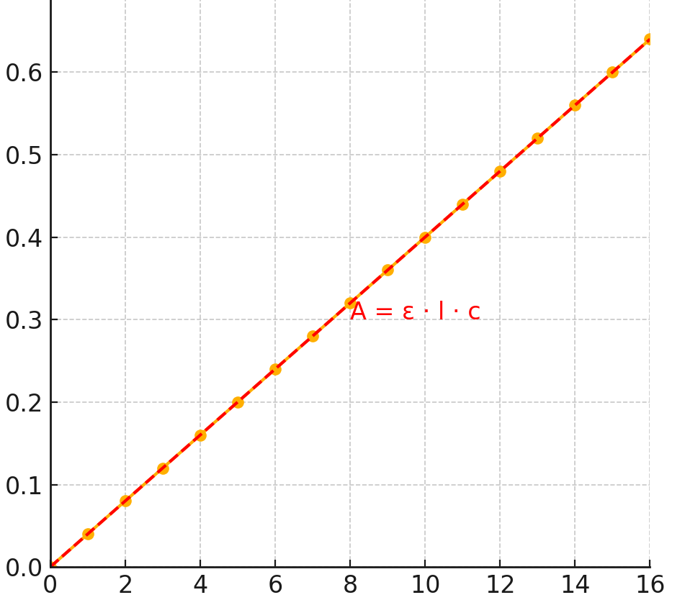
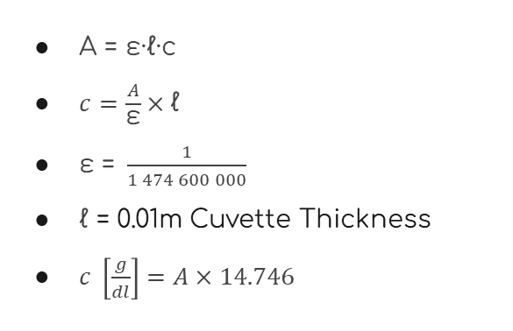
Beer-Lambert law
A = ε·ℓ·c
$c=\frac{A}{\text{ε}}×\text{ℓ}$
$\text{ε} \text{= }\frac{1}{1 474 600 000}$
$\text{ℓ}$ = 0.01m Cuvette Thickness
$c \left[\frac{g}{dl}\right]=A×14.746$
Notes:
Beer–Lambert law: $A = \epsilon \cdot \ell \cdot c$. In words, absorbance = molar absorptivity × path length × concentration. For a 1 cm cuvette, $A \propto c$. A linear plot of absorbance vs. concentration should be a straight line through the origin
A = ε × l × c (linear relationship)
A … Absorbance
ε … molar absorbivity of substance
ℓ … path length
C … concentration of substance in sample
Speaker Notes:
Absorbance ∝ concentration
1 cm path length, ε known
Linear graph confirms Beer’s Law
Plug in absorbance → calculate Hb

Slide 9
Reflotron as alternative
System
How it works
Advantages
reflectance photometer
dry reagent test strips
drop of blood on test strip, system handles the rest
strip has reagents ➡️ color change proportional to hemoglobin concentration
measures the intensity of light reflected
calculates Hb concentration; on-board calibration for each test
Rapid results (~2–3 minutes per test)
small sample volume
no toxic chemicals
user-friendly
Notes:
Portable device, test strips
Drop of blood → reflectance photometry
Fast (~2 min), no toxic reagents
Device unavailable during lab
Speaker Notes:
Reflotron = point-of-care analyzer
Reflectance, not absorbance
Color change on strip → Hb value
Safer, faster, convenient
Not used: malfunctioned during session

Slide 10
Results male vs female
Group | # Participants | Range | Mean | SD | Variance
Female | 12 | 10.1 – 17.3 g/dl | 12.1 | 4.3 | 19.9
Male | 10 | 10.9 – 23.0 g/dl | 16.7 | 3.5 | 13.5
Notes:
Each lab participant measured their blood hemoglobin. We separated the results by sex to investigate any difference between male and female students. (Placeholders for sample data).
M > F expected (testosterone, RBC)
Observed trend: In our class data, the males showed a higher average Hb than females (placeholder observation). This is consistent with known biological differences: normal hemoglobin reference ranges are ~14.0–17.5 g/dL for adult men and ~12.3–15.3 g/dL for adult womenmy.clevelandclinic.org. (Our sample means should fall in these ranges, barring any anomalies.)
This is largely due to hormonal differences (testosterone tends to stimulate higher red blood cell production) and other factors like body iron stores. The normal reference range for adult men is roughly 14 to 17 or 18 g/dL, and for adult women it’s about 12 to 15 g/dLmy.clevelandclinic.org. In our class data, we indeed observed that the male mean was higher than the female mean (assuming that holds true once we plug in the real data).
However, just seeing a difference doesn’t tell us if it’s a statistically significant difference or just due to the specific individuals in our small sample. To address that, we plan to perform an unpaired t-test comparing the two groups. The t-test will tell us if the difference in means is likely a real difference in the populations (male vs female students) or if it could have occurred by chance. We’ll outline that analysis on the next slide.

Slide 11
t-Test comparison
Key Values
t-Statistic | 2.63
critical t-Value | 1.72
p-Value | 0.81%
Cohen’s d | 0.32
Key findings
significant differences between m. vs f.
p-Value: 0.81% < 5% (chosen α)
t-Value: 2.63 > 1.72
small difference ⬅️ 0.2 ≤ d < 0.5
Conclusions
1
the HiCN photometric method is “gold standard” for accuracy
2
Reflotron provides speed and ease of use
Notes:
Speaker Notes: To statistically assess the difference between male and female hemoglobin levels in our data, we performed an independent two-sample t-test. The null hypothesis is that the average hemoglobin is the same for males and females. The alternative hypothesis is that they differ (most likely, we suspect the male average is higher).
On the slide, we have the formula for the t statistic: it’s the difference between the two sample means divided by the standard error of the difference. The standard error term $\sqrt{\frac{s_M^2}{n_M} + \frac{s_F^2}{n_F}}$ combines the variance from both groups (Welch’s t-test formulation, which does not assume equal variances). If we did assume equal variance, we’d use a pooled variance in that denominator, but it’s safer with small samples to not assume that.
We will insert our actual mean and standard deviation values into that formula. Right now it’s shown with placeholders: for instance, if the male mean was 15.2 and female mean 13.8, and respective SDs were 0.8 and 0.5, and sample sizes e.g. 5 and 5, we would compute t ≈ (15.2–13.8) / sqrt((0.8²/5) + (0.5²/5)). That’s a numeric example; the actual values will be plugged in.
After computing t, we need the degrees of freedom to interpret it. Using Welch’s formula, the df will be a non-integer (we’ll likely use software or a calculator for the p-value). If we had equal sample sizes and similar variances, the df is roughly n_M + n_F – 2. Let’s say we ended up with around df ≈ 8 (for example).
We then determine the p-value associated with our calculated t. If the p-value is less than 0.05, we conclude that the difference in male vs female means is statistically significant at the 95% confidence level. That would mean it’s very likely that male and female students in our population do have different average hemoglobin. If the p-value is higher than 0.05, we conclude that our data do not show a significant difference – meaning any observed difference could just be random variation.
We’ll fill in the actual t value, df, and p-value after crunching the numbers. For example, if t (calculated) was around 2.1 and the p-value came out to 0.065, that would NOT be significant at 0.05 (we’d say trend but not significant). If t was larger, say 3.0, and p = 0.015, that would be significant. We’ll see what the class data yields once analyzed.
Speaker Notes:
Unpaired t-test: M vs F
H₀: no difference in means
Insert class data → calc t, df
Get p-value → interpret
p < 0.05 = significant difference
HiCN = accurate, reproducible
Photometry: reliable lab method
Reflotron = fast, easy, less precise
Male > female Hb confirmed (likely)
Safety: cyanide handling, blood hygiene
Speaker Notes Keywords:
HiCN method = reference
Accurate, stable, standard
Reflotron = fast but fragile
Results reflect biology (M > F)
Safe lab practices
Spectrophotometry = hands-on insight

Slide 12
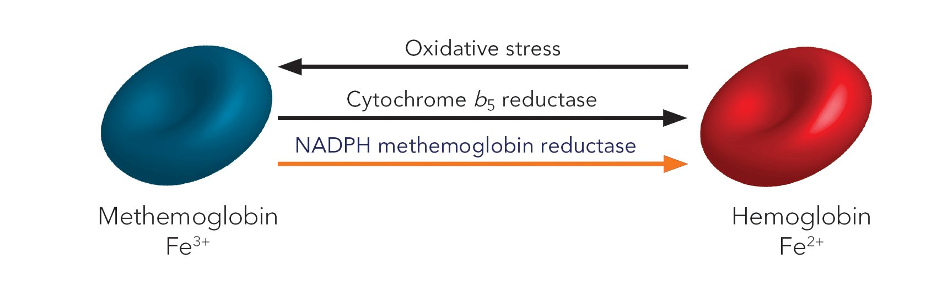
Thanks!
Do you have any questions?

